Slide 1
Segmentation and patterning in Drosophila
BCH 512 Developmental Genomics
Figures drawn primarily from Gilbert “Developmental Biology” and Wolpert “Principles of Development”

Slide 2
This week: Patterning in the Anterior-Posterior Axis (segmentation)
Week 2—Tues: no class
Week 2—Thurs: Paper discussion: Dorsal-Ventral patterning I
Week 2—Friday: Paper discussion: Dorsal-Ventral patterning II
Week 3—Tues: no class
Week 3—Thurs: Paper discussion: Dorsal-Ventral patterning III
Week 4—Tues: Paper discussion: Dorsal-Ventral patterning IV
Week 4—Thurs: Finish up, Review, Musical summation

Slide 3
Why Flies?
short generation time (~ 12 days)
many visible phenotypes
only 4 chromosomes (3 autosomes, X&Y)
good genetic and physical maps (polytene chromosomes)
easy transgenesis
19+ sequenced genomes

Slide 4
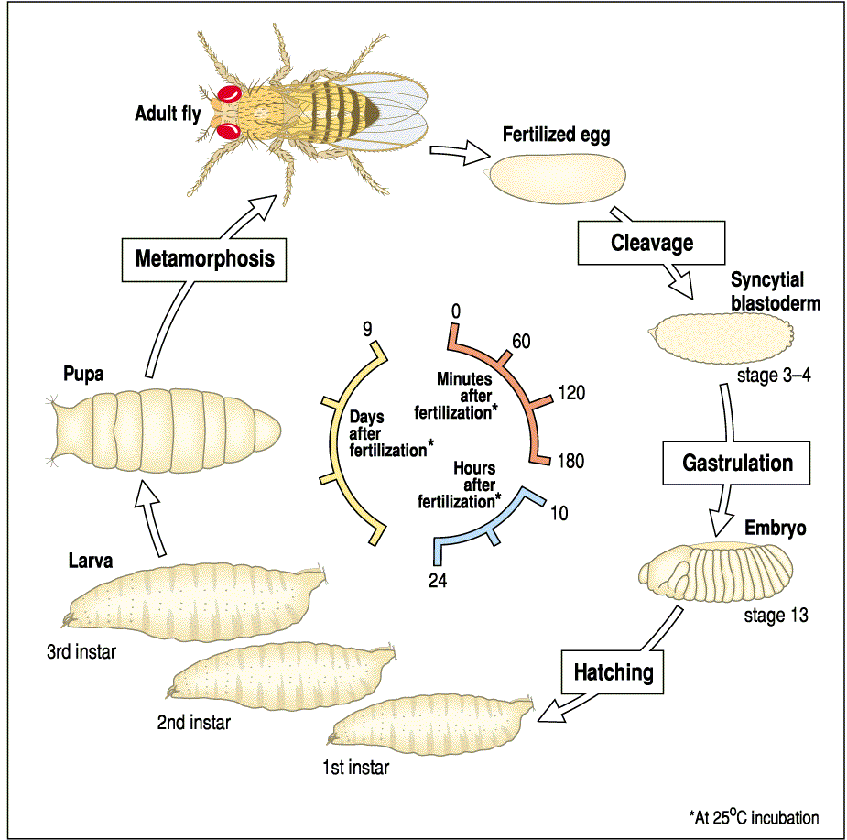
The Drosophila Life Cycle

Slide 5
Cleavage vs. Syncytial Development
mouse
fly

Slide 6
stages of embryogenesis

Slide 7
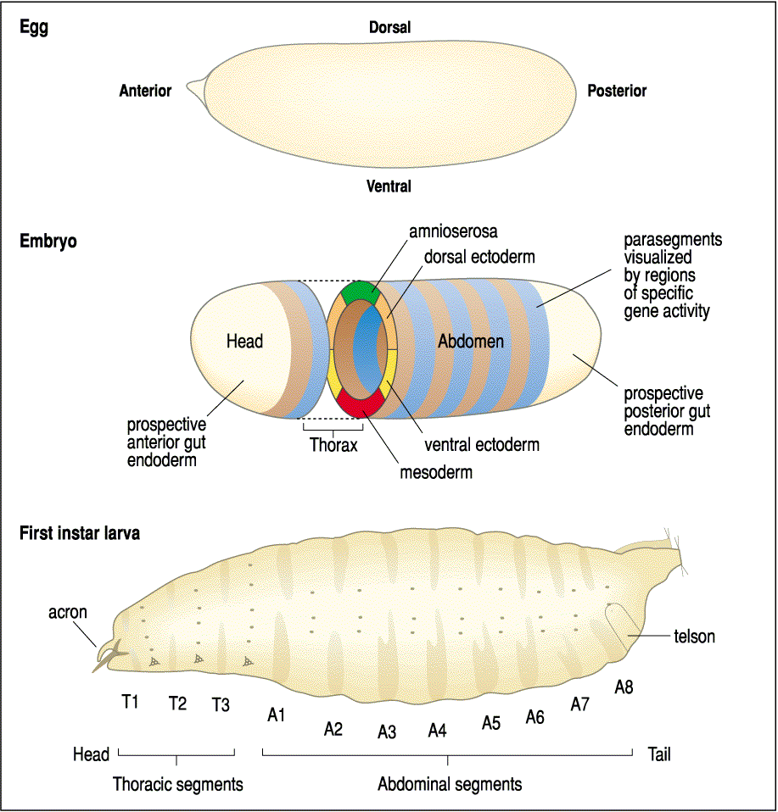
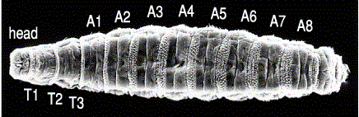
Main body axes and patterning by maternal effect genes
Termini

Slide 8
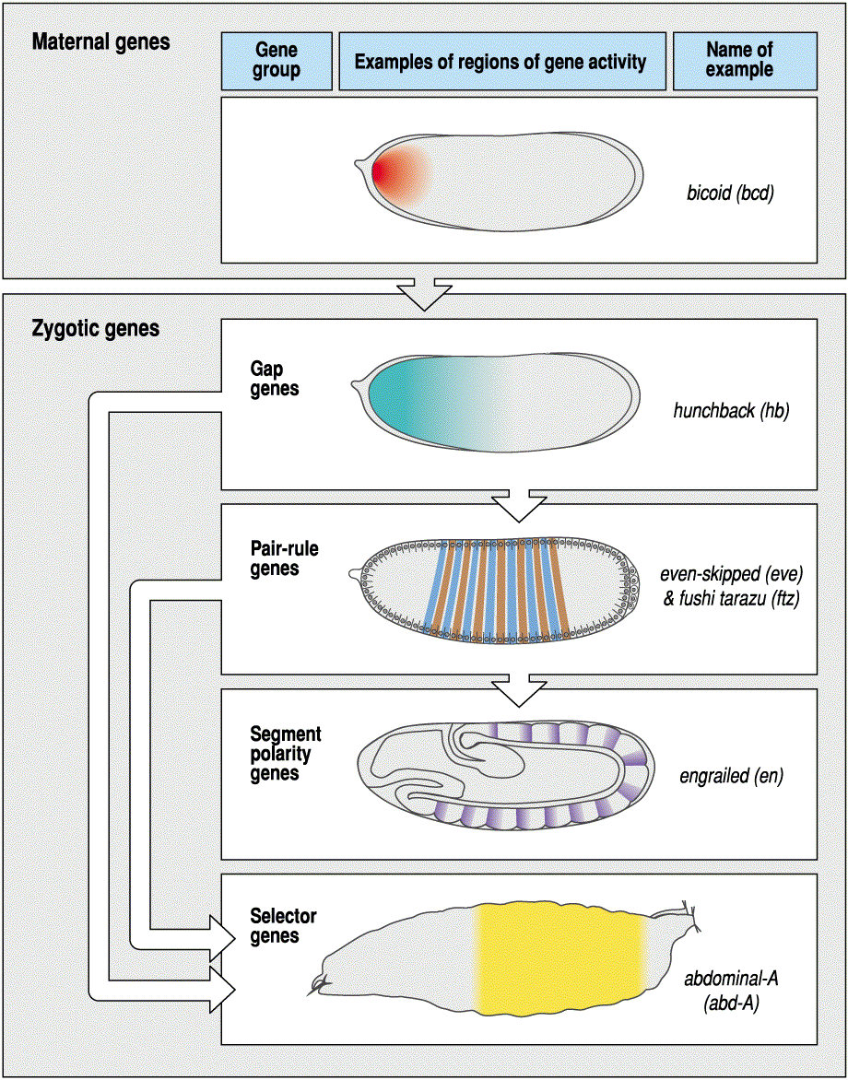
Sequential expression of different sets of genes establishes the body plan along the antero-posterior axis

Slide 9
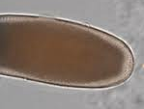
Egg development in Drosophila
(somatic)
(somatic)
(germline)
(germline)
(germline)
(germline)
(germline)
plasma membrane
perivitelline space
vitelline membrane

Slide 10
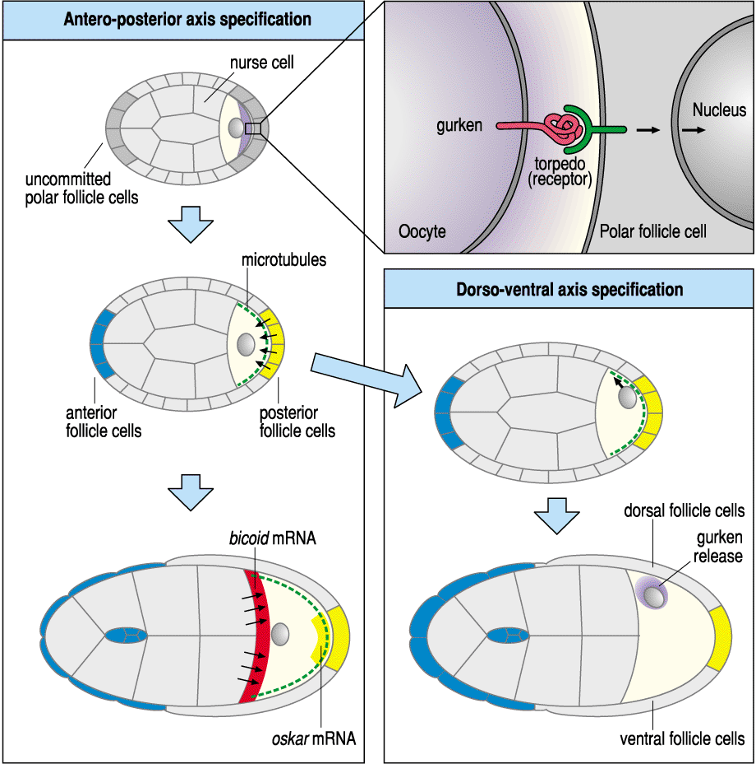
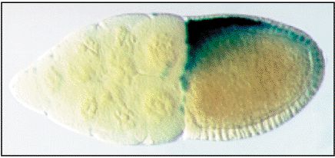
The oocyte has an intrinsic polarity, specified by the position of the nucleus
(TGFα)
(EGF-R)

Slide 11
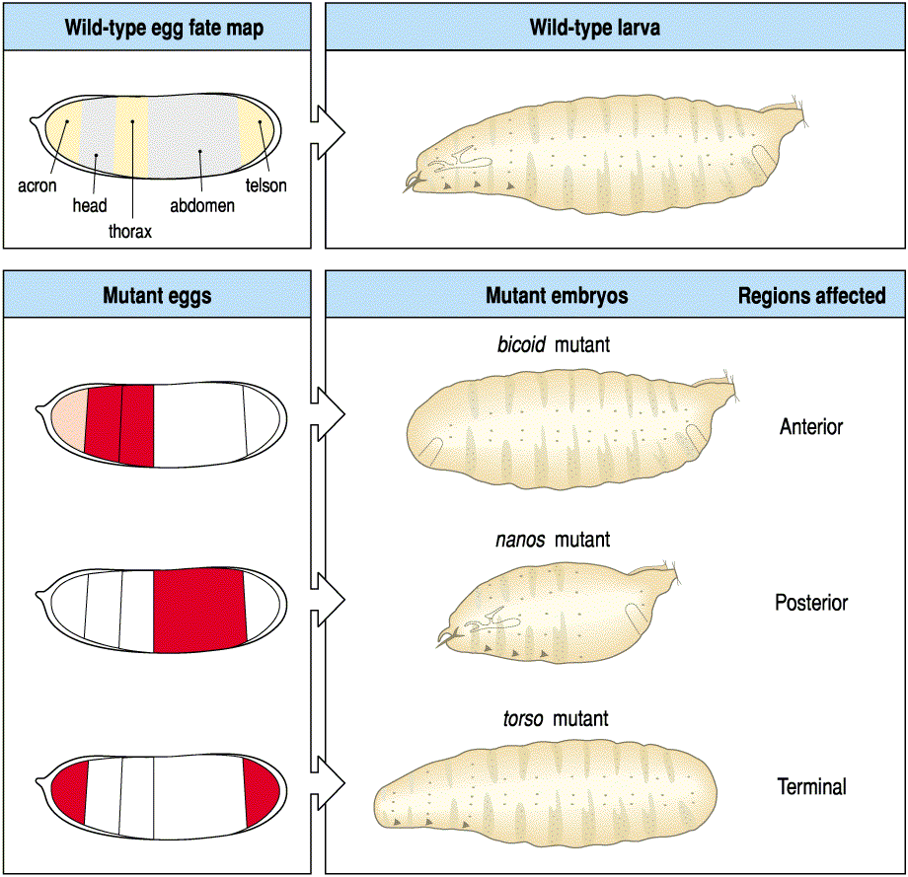
Anterior-Posterior Axis
Separate groups of genes pattern the A-P axis (anterior, posterior, terminal)
the syncytial nature of the embryo is critical here
much of the process is driven by RNA localization and repression of translation (leading to protein gradients)
zygotic genes respond to these gradients
syncytium allows diffusion/transport
cellularization requires signalling

Slide 12
Anterior-Posterior Axis
Separate groups of genes pattern the A-P axis (anterior, posterior, terminal)
the syncytial nature of the embryo is critical here
much of the process is driven by RNA localization and repression of translation (leading to protein gradients)
zygotic genes respond to these gradients
Anterior group genes:
bicoid (bcd)
exuperantia (exu)
swallow (swa)
Posterior group genes:
nanos (nos)
tudor (tud)
oskar (osk)
vasa (vas)
valois (val)
pumilio (pum)
caudal (cad)

Slide 13
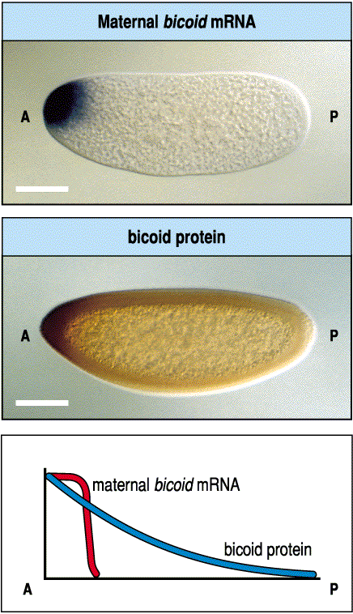
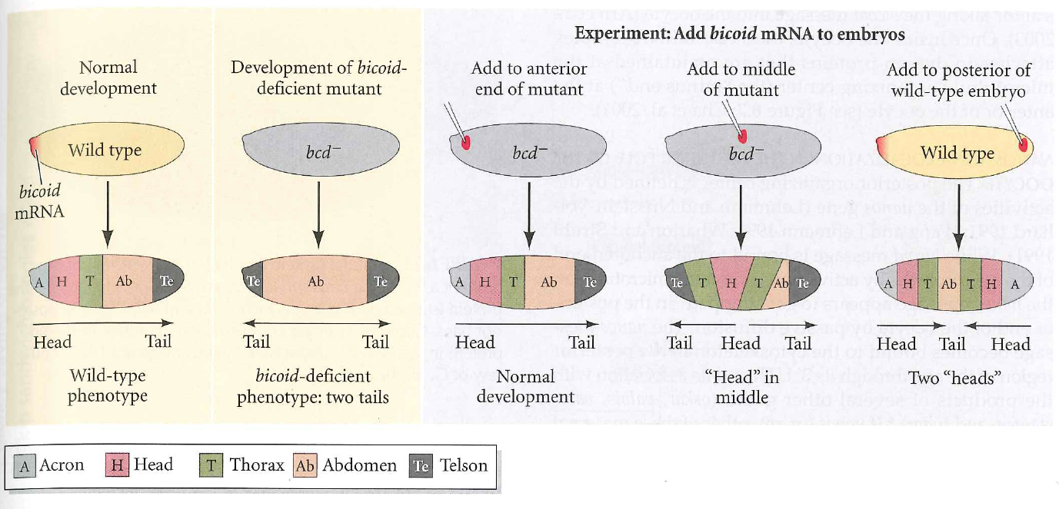
Anterior-Posterior Axis: The Anterior Morphogen
the syncytial nature of the embryo is critical here
much of the process is driven by RNA localization and repression of translation (leading to protein gradients)

Slide 14
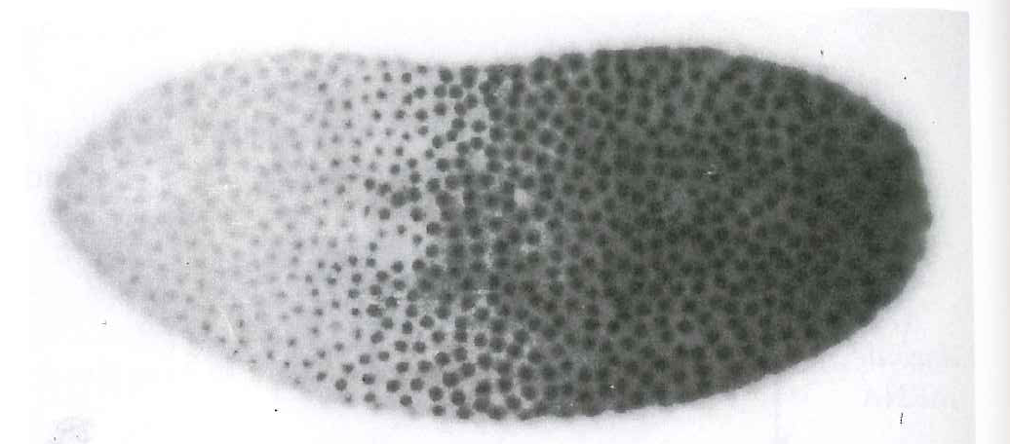
Anterior-Posterior Axis: The Posterior Morphogens
the syncytial nature of the embryo is critical here
much of the process is driven by RNA localization and repression of translation (leading to protein gradients)
Cad

Slide 15
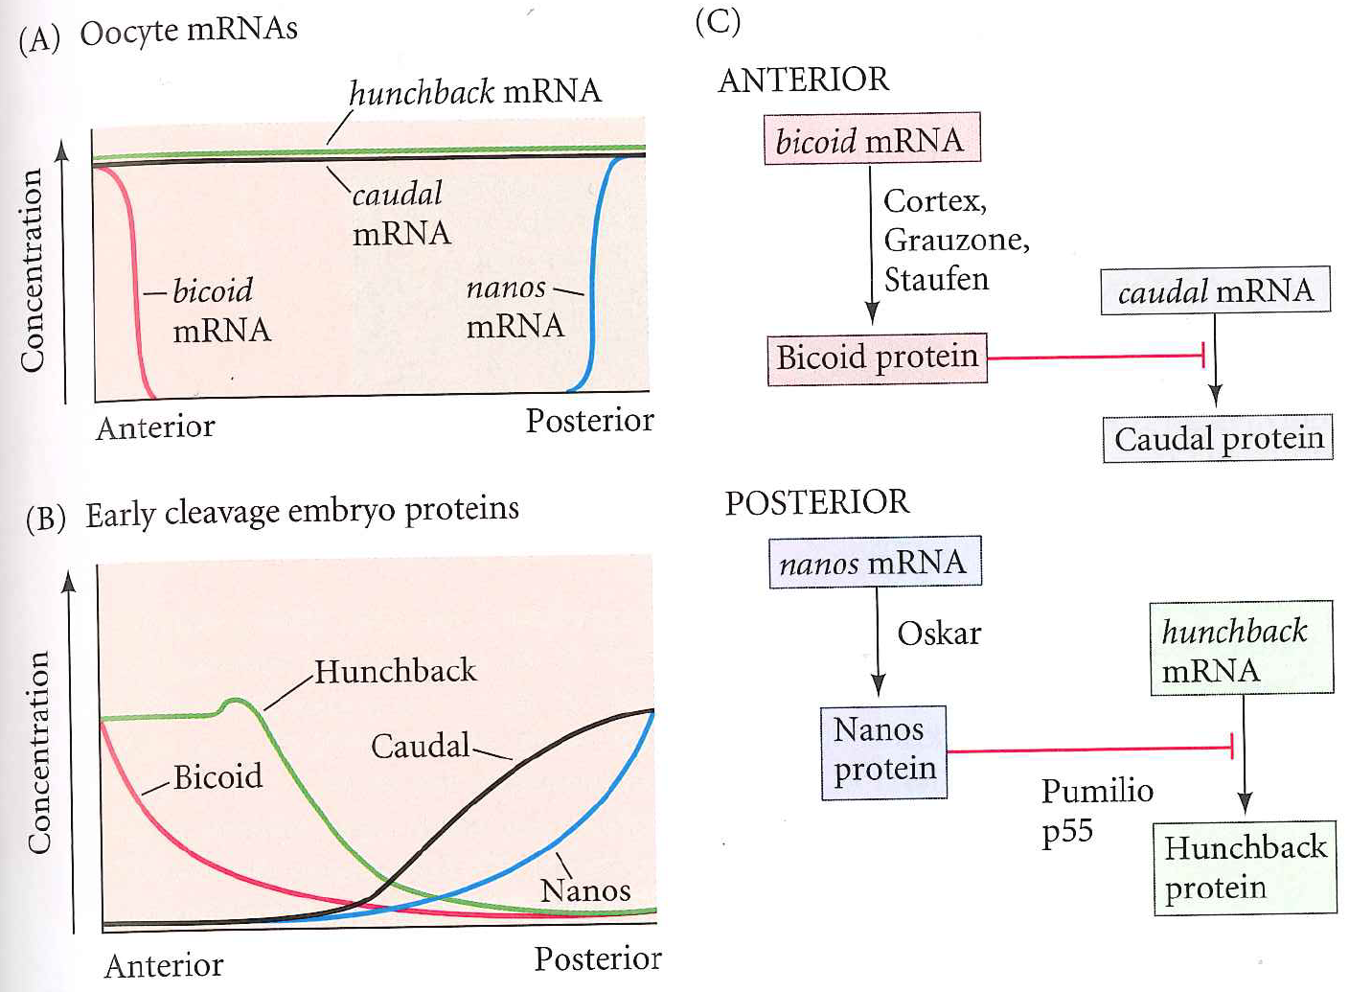
Key concepts in anterior/posterior patterning:
localized RNA (bcd, nos)
translation inhibition (cad, hb by bcd, nos)
morphogen gradients and diffusion/transport

Slide 16
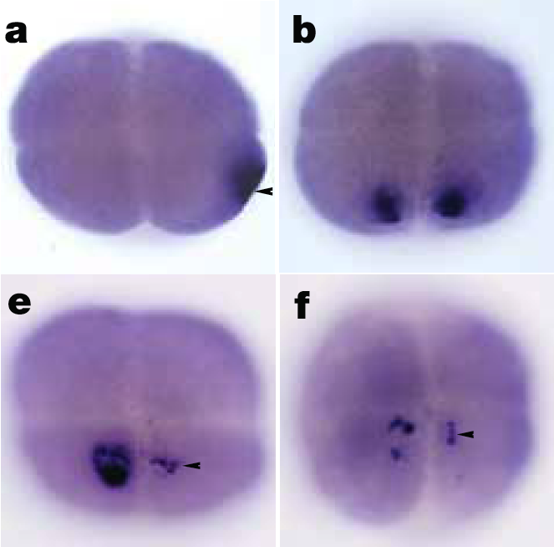
Maternal localization of sqt RNA in zebrafish presages the dorsal axis
Gore et al. 2005

Slide 17
Sequential expression of different sets of genes establishes the body plan along the antero-posterior axis

Slide 18
Segmentation I : The power of genetics
saturation mutagenesis of Drosophila by Nüsslein-Volhard, Wieschaus, et alia
scored pattern of larval denticle belts in lethal mutations
anterior
posterior

Slide 19
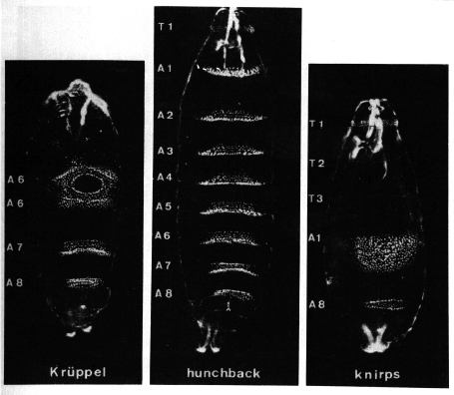
Gaps:

Slide 20
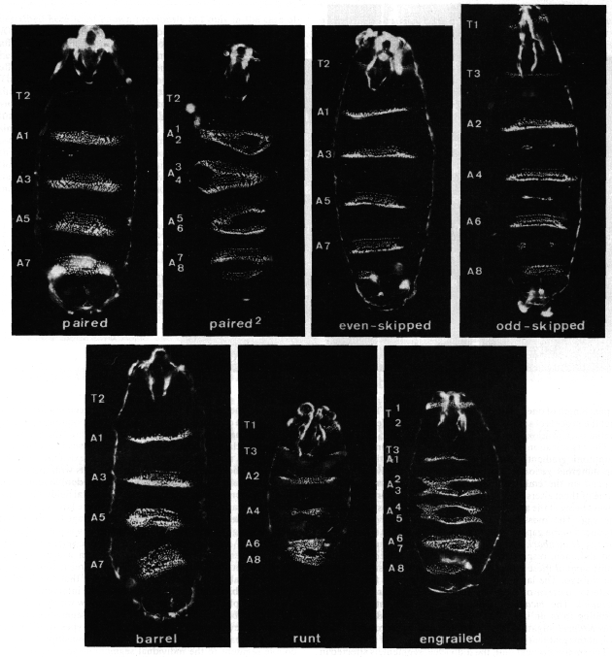
Every other:

Slide 21
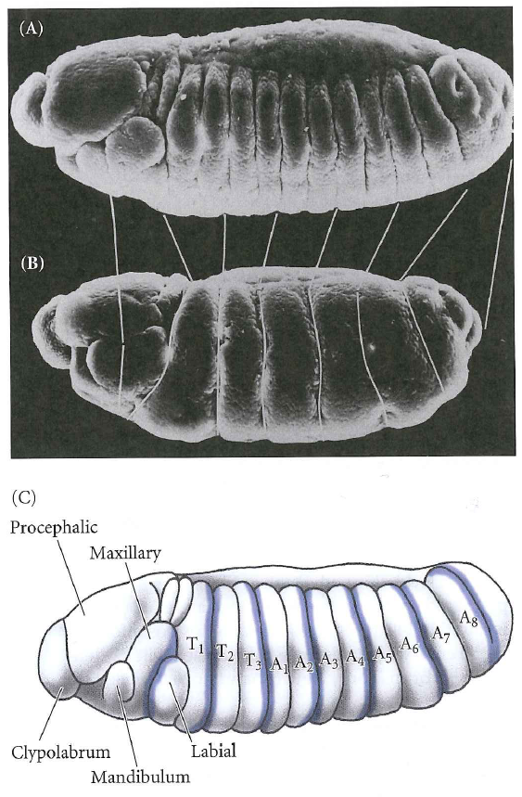
Every other: ftz

Slide 22
Mirroring:

Slide 23
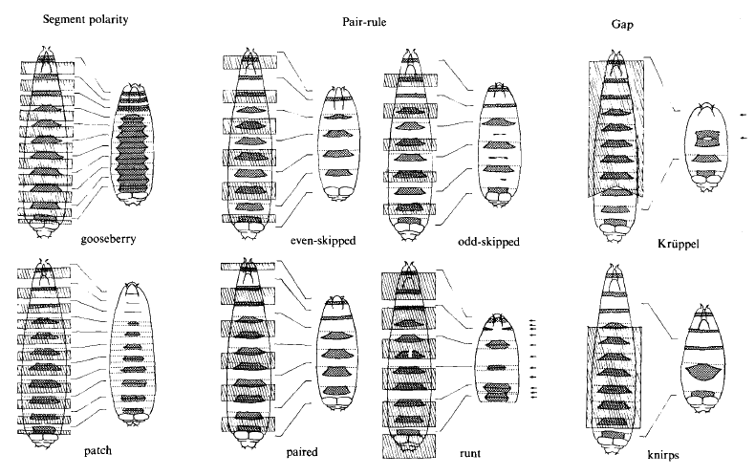

Slide 24
Summary of gene classes in segmentation
Gap genes set up broad regions along the A-P axis
Pair-rule genes establish the parasegments
Segment polarity genes divide the parasegments into anterior and posterior compartments

Slide 25
Segmentation II: molecular bio
Most have been cloned
These discoveries have had an enormous impact and drive large parts of today’s research in vertebrate development and in medicine
The molecular data are quite striking…

Slide 26
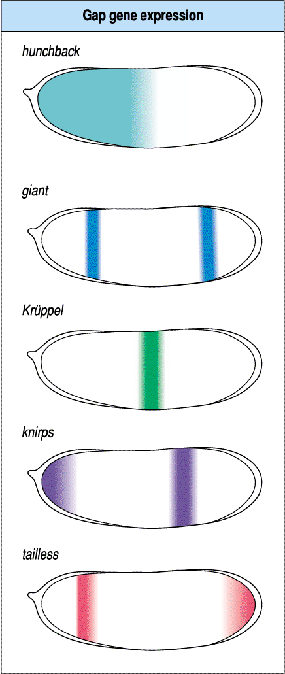
Gap Genes:
are expressed in discrete domains
are transcription factors

Slide 27
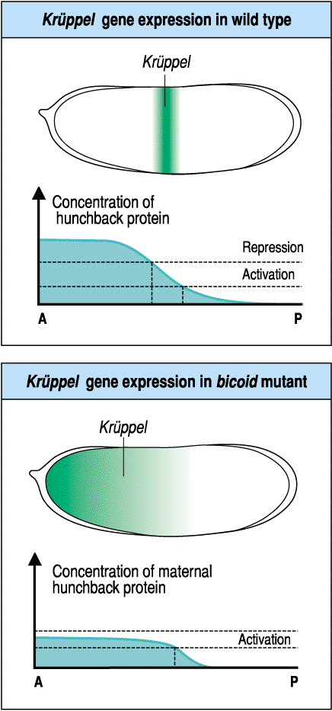
Gap Genes continued:
read the maternal gradients of bcd, hb, and cad (dependent on syncytial nature of embryo)

Slide 28
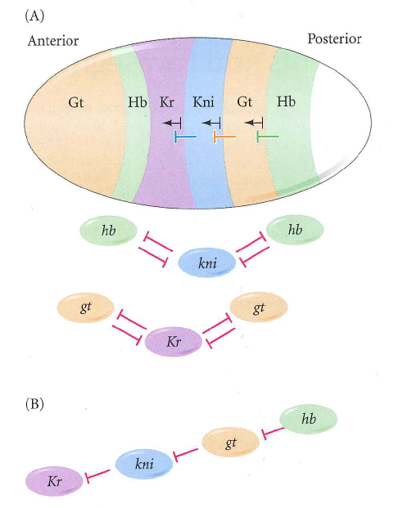
Gap Genes continued:
exhibit mutual repression that refines their patterns of expression

Slide 30
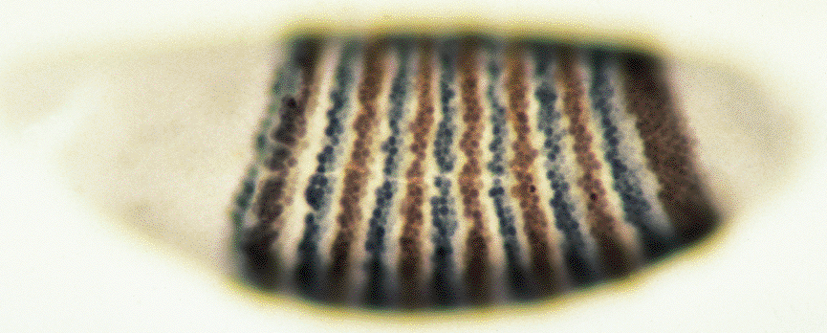
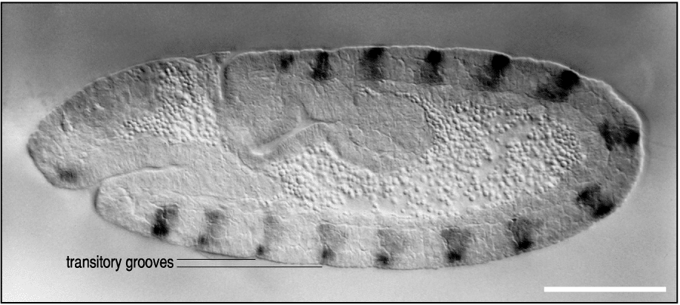
Pair-rule Genes
also transcription factors
define and are expressed in alternating parasegments
the 14 parasegments are visible as transient grooves following gastrulation
initially all same but will ultimately have unique identities
offset from segments by ~1/2
eve (blue)
ftz (brown)

Slide 31
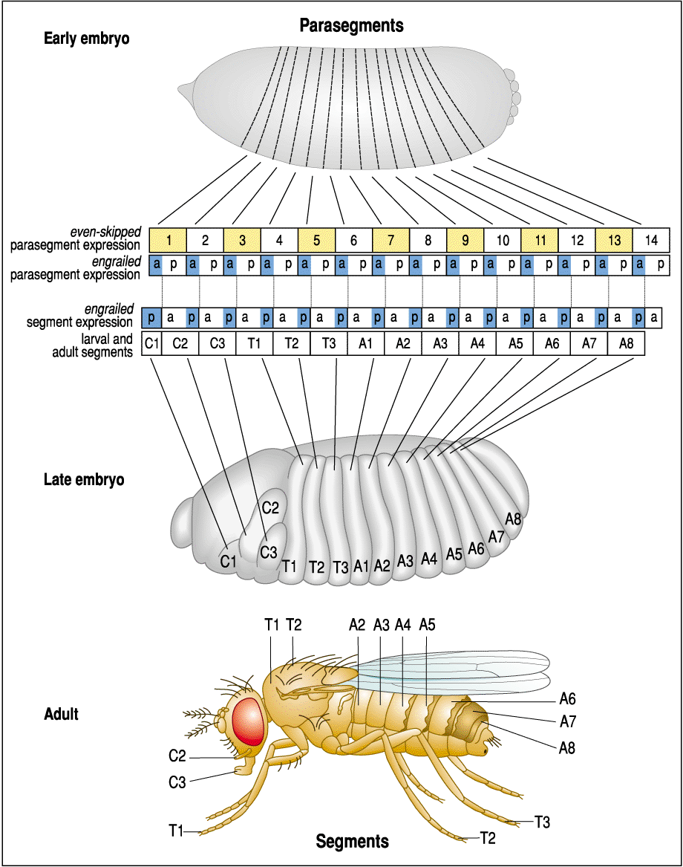

Slide 32
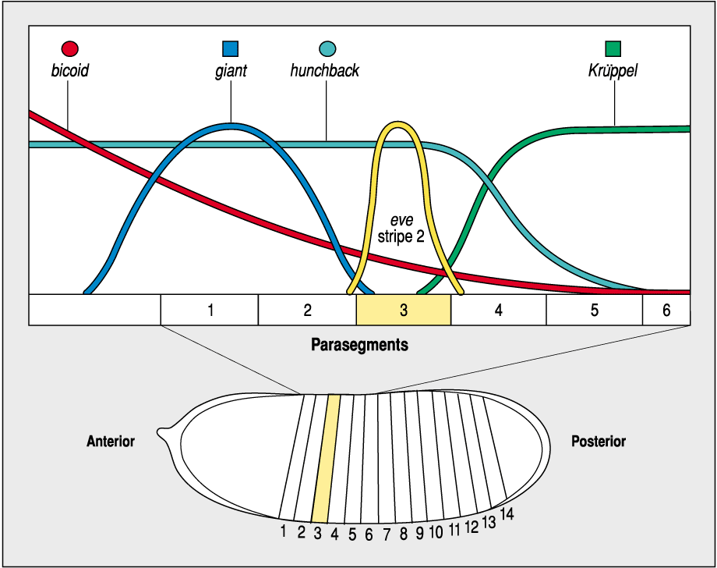
More pair-rule genes
pair-rule gene expression is regulated by the gap genes, and the maternal genes (still in syncytium)
competition between activators and repressors is important
stripes are independently regulated

Slide 33
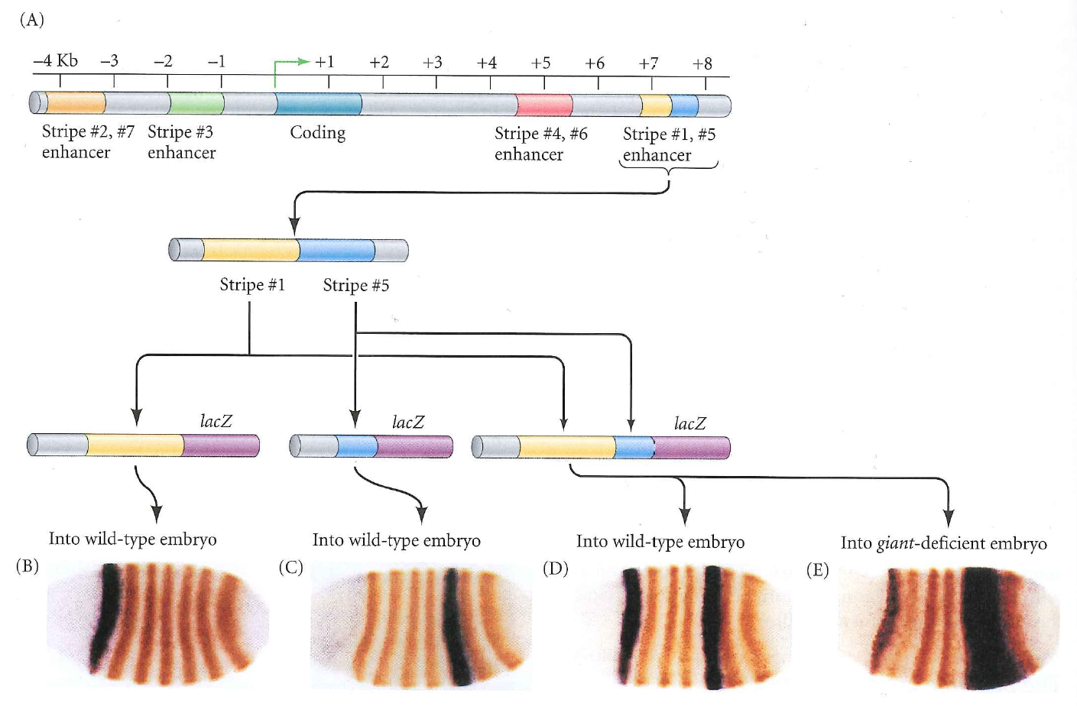
More pair-rule genes
stripe 5
what about in a gt mutant?

Slide 35
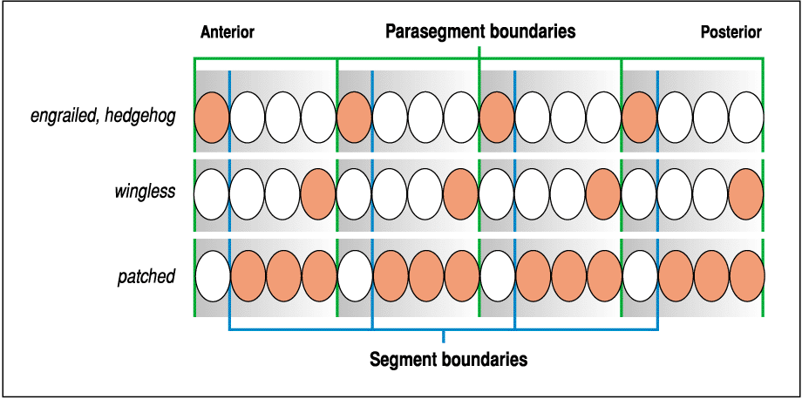
Segment polarity genes
not all tx factors—most are involved in cell-cell signaling (this makes sense, because no longer have syncytial embryo)
expressed in a portion of each parasegment
pattern the segments and clarify boundaries

Slide 36
Segment Polarity Genes: Initial expression is regulated by the pair-rule genes

Slide 37
Segment Polarity Genes: subsequent expression depends on reciprocal signaling between wg and en/hh expressing cells

Slide 38
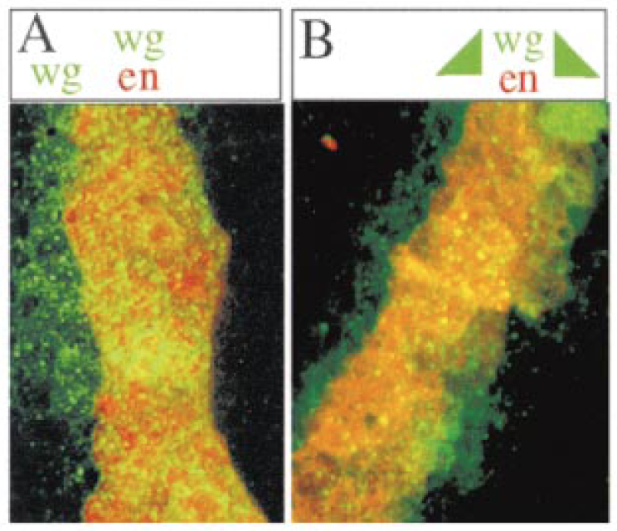
Segment Polarity Genes: asymmetry of the Wg and Hh morphogen gradients leads to differential cell fates
wt
hh⁻
Sanson et al. (1999). Cell 98:207–216

Slide 39
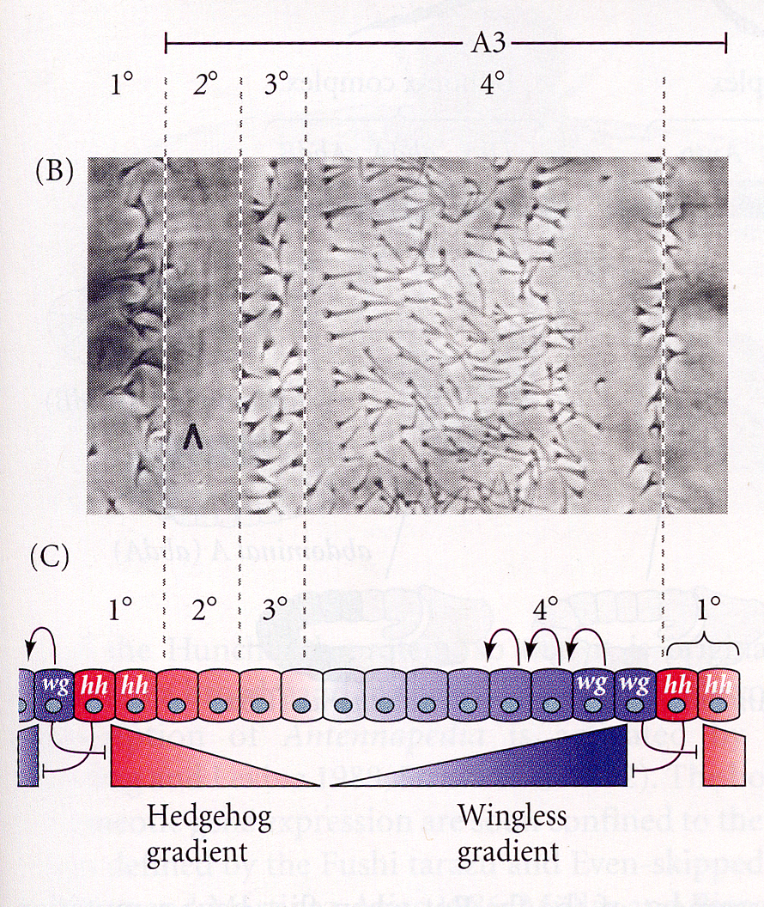
Segment Polarity Genes: asymmetry of the Wg and Hh morphogen gradients leads to differential cell fates

Slide 40
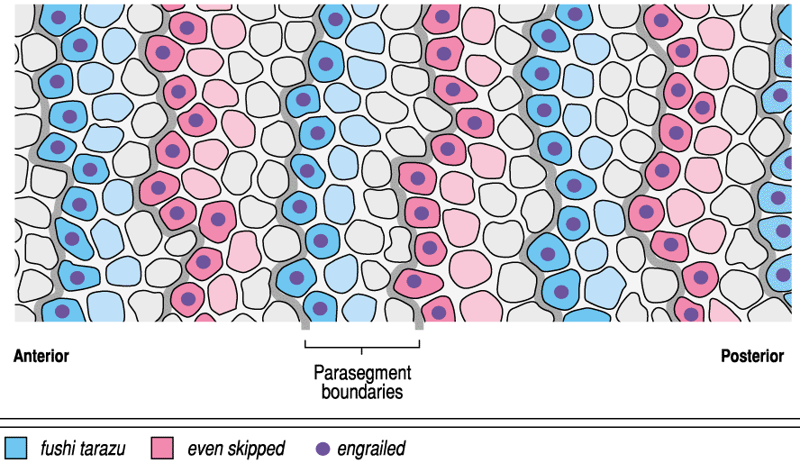
Segment Polarity Genes: engrailed (en) establishes a true compartment boundary (i.e., no mixing of cells between parasegments)

Slide 41
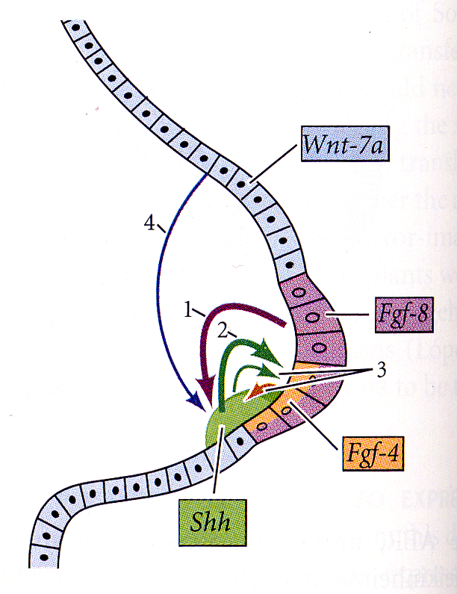
The developing vertebrate limb
Interactions between Wg (Wnt) and HH (Shh), like we saw in the fly embryo

Slide 43
Segmental Identity

Slide 44
Homeotic mutation (Bateson, 1894):
A mutation in which one normal body part is replaced with another

Slide 45
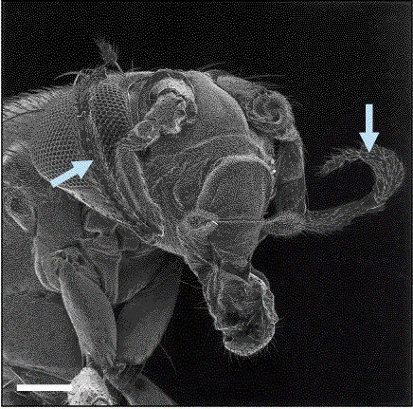
Some of the famous ones…
Ultrabithorax (Ubx)
Antennapedia (Antp)

Slide 46
The Hox genes specify the identity of a field (segment), not the formation of the field.
Contrast this to the segmentation genes, which establish the segments themselves.

Slide 47
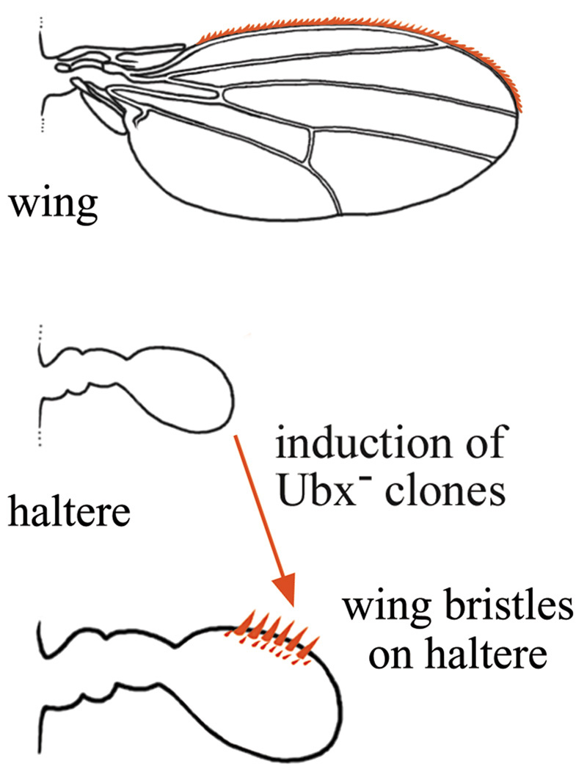
The Hox genes act cell autonomously, working within cells to select their developmental fate.

Slide 48
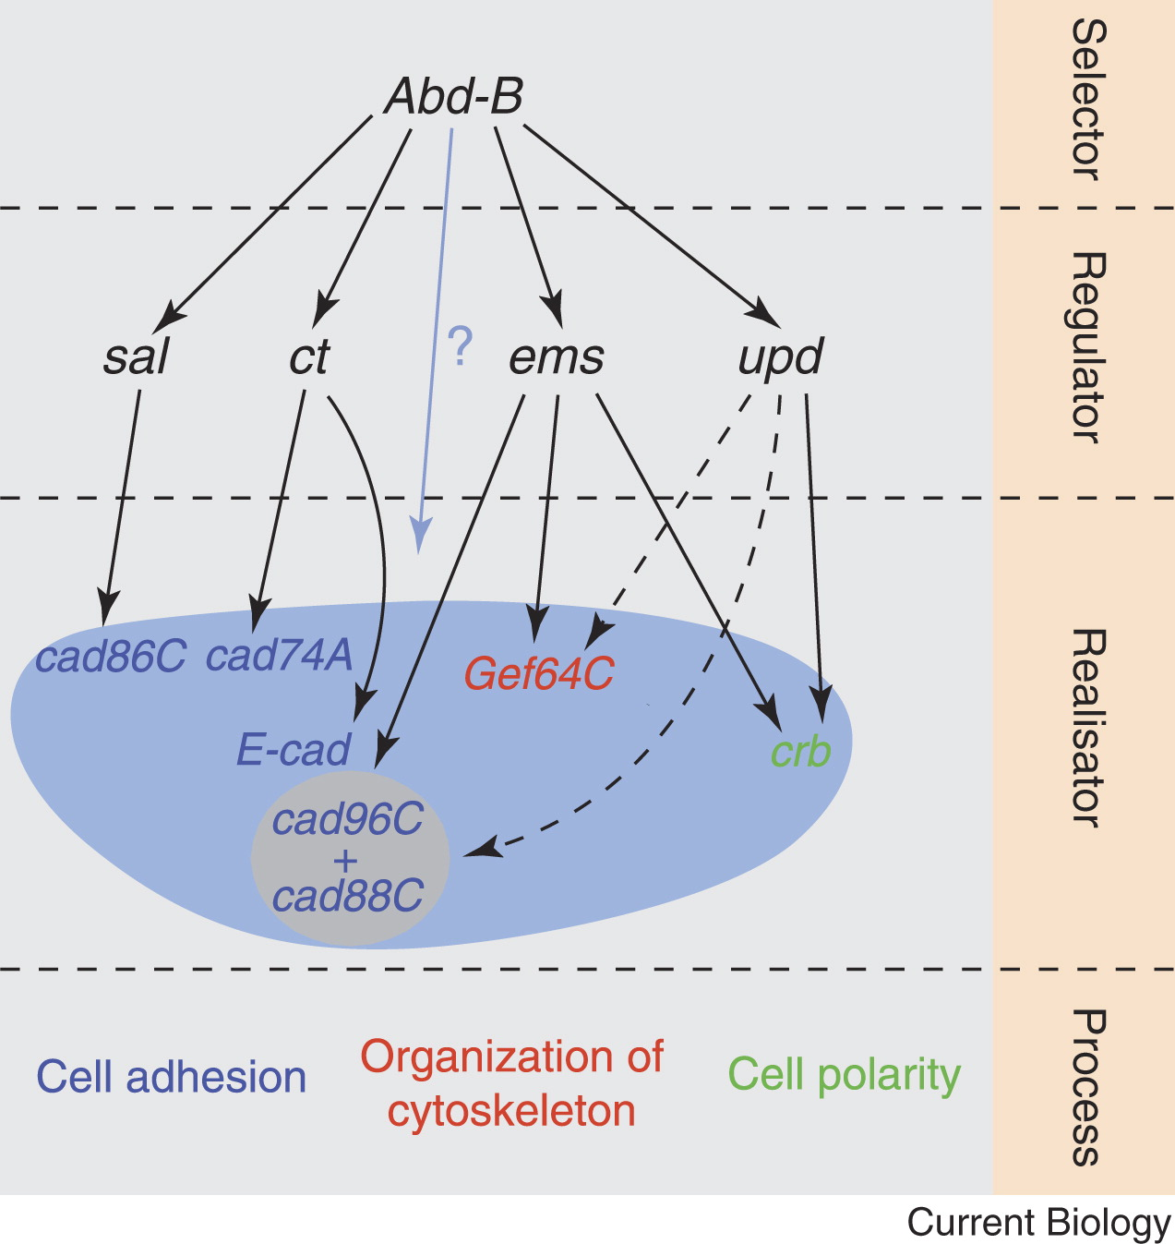
Thus they are sometimes called “selector” genes—they select the future developmental path of the segment, controlling whole later developmental programs
Current Biology Volume 16, Issue 23 2006 R988 - R989

Slide 49
Some of the famous ones…
Ultrabithorax (Ubx)
Antennapedia (Antp)

Slide 50
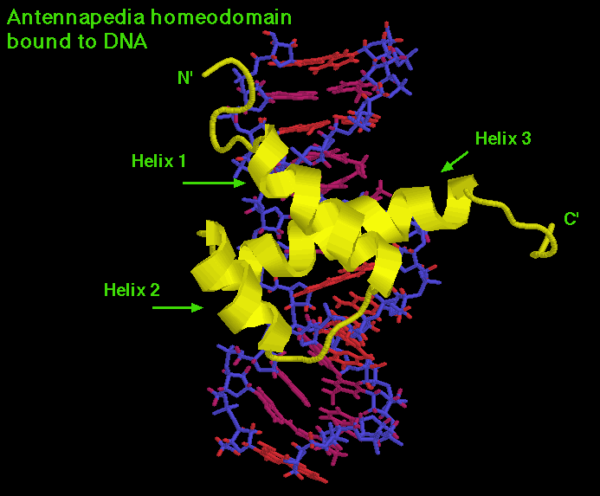
The Hox genes are all transcription factors and are related in their DNA binding domains, the homeobox

Slide 51
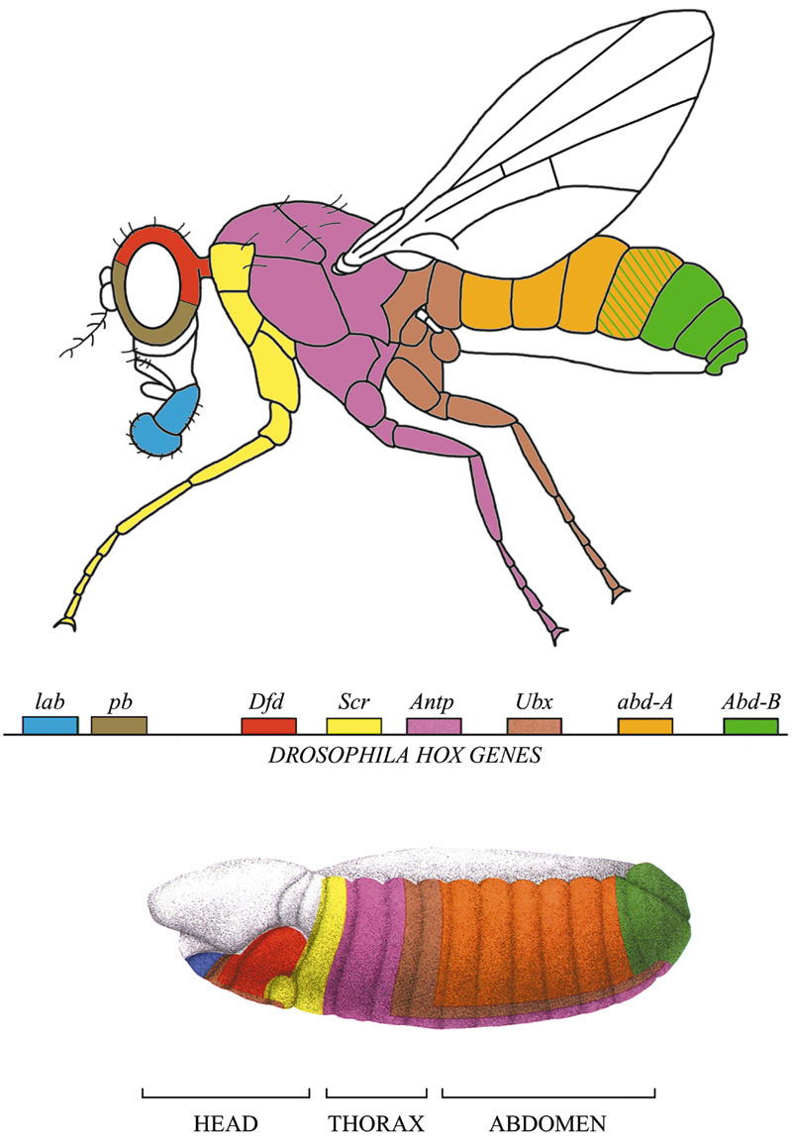
In the fly, there are two main clusters of Hox genes: the Antennapedia Complex (ANT-C) and the Bithorax Complex (BX-C). Strikingly, their order on the chromosome is identical to their order of expression in the A/P axis.
ANT-C
BX-C

Slide 52
In a Ubx mutant, Antp expands into T3, causing a homeotic mutation of T3 into T2 (which has wings). More posterior segments are unaffected due to repression of Antp by Abd-A.
Ubx⁻
ANT-C
BX-C

Slide 53
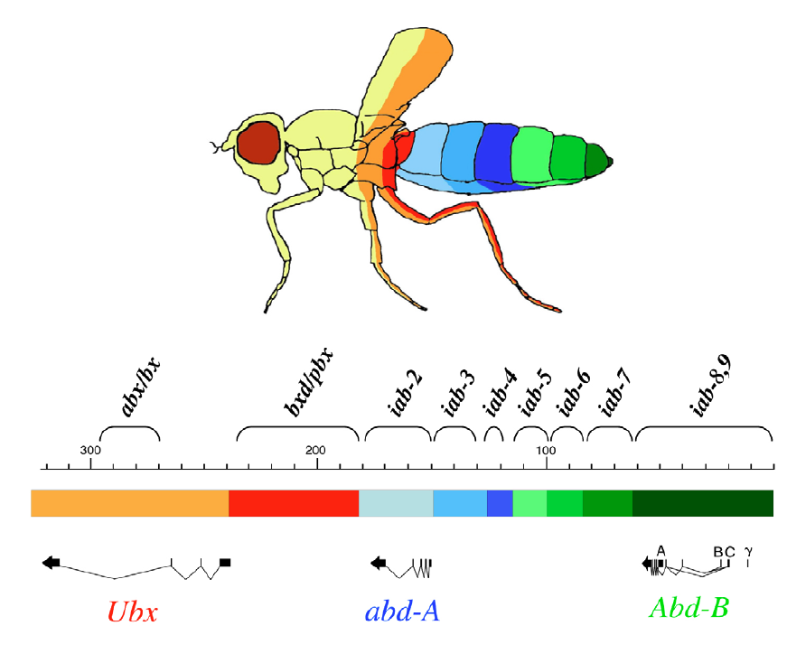
Although there are only 3 genes in the BX-C, there is a complex regulatory structure that causes segment-specific phenotypes in various mutants.
Maeda and Karch 2006

Slide 54
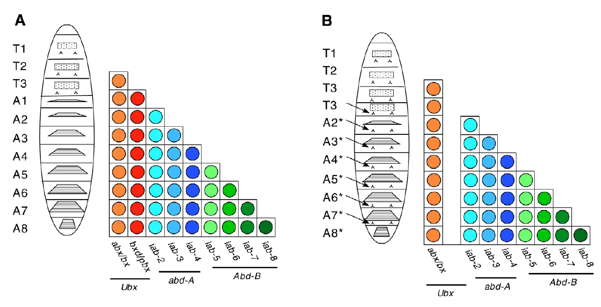
For example, the bxd/pbx mutation causes a transformation of A1-> T3 and a partial transformation of more posterior segments.
Maeda and Karch 2006

Slide 56
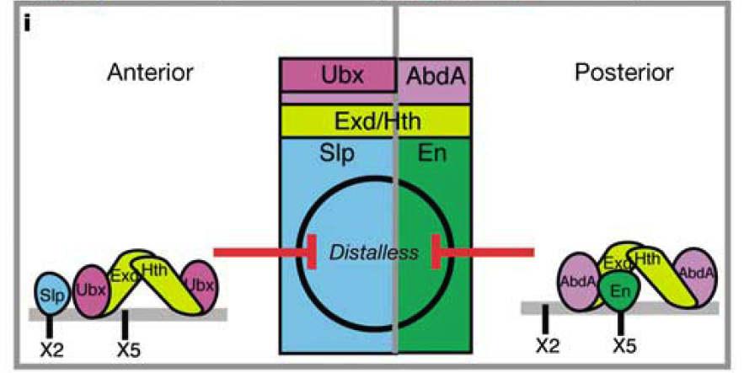
The Hox genes control the expression of important segment-specific and organ-specific genes, usually other transcription factors, which in turn control whole developmental programs.
For example, Scr activates the forkhead tx factor, which controls development of the salivary gland.
Ubx and Abd-A repress distal-less in abdominal segments, preventing the development of appendages. This also requires segmentation gene input.

Slide 57
Thus they are sometimes called “selector” genes—they select the future developmental path of the segment, controlling whole later developmental programs
Current Biology Volume 16, Issue 23 2006 R988 - R989

Slide 58
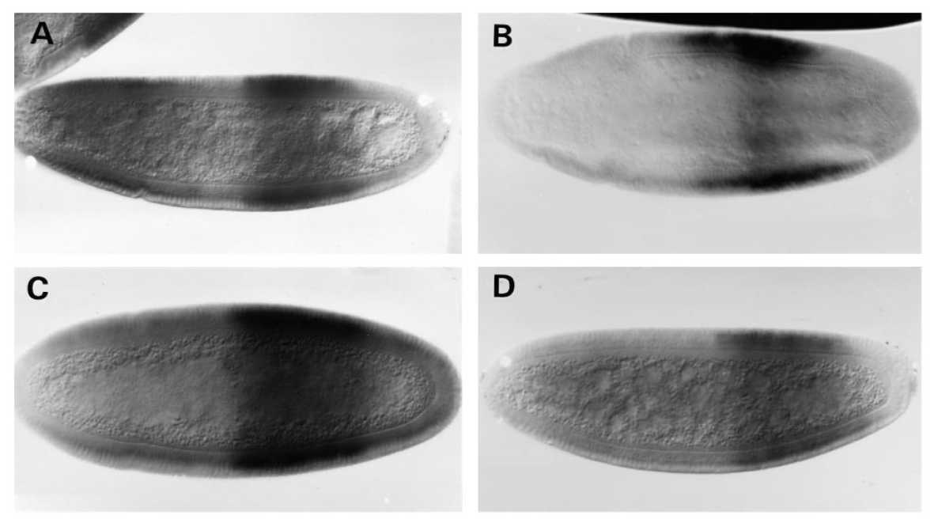
Initial expression depends on gap and pair-rule genes
WT
hb
Kr
tll
Abd-A in situ hybridization
Casares and Sanchez-Herrero 1995

Slide 59
Maintenance of expression is via epigenetic mechanisms.
Polycomb group (Pc-G) genes keep homeotic genes repressed in segments where they were not intially activated.
Trithorax group (trx-G) genes maintain the expression of the homeotic genes in their appropriate segments.
Both groups act by modifying chromatin conformation. PcG complexes promote H3K27 tri-methylation. TrxG complexes can promote H3K4 methylation. Many details remain to be established.
In this way, patterning information conveyed by the early activity of the segmentation genes is preserved throughout the life cycle.

Slide 60
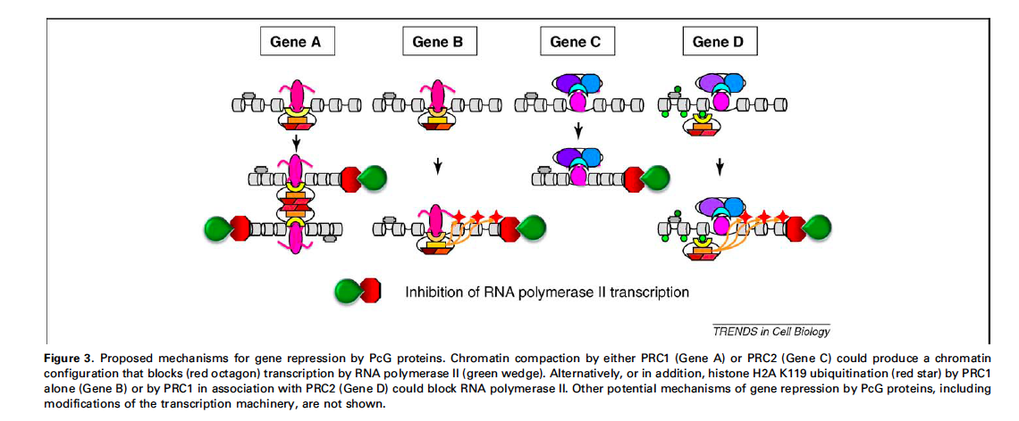
Kerppola (2009) Trends Cell Biol. 19:692-704

Slide 61
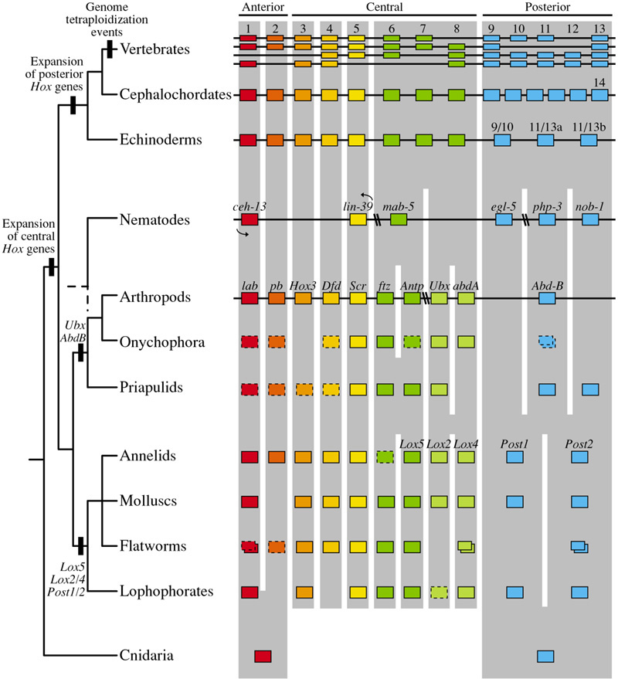
The Hox genes appear as far back as the Cnidaria. In vertebrates, there are four copies of the Hox cluster. Not every gene is maintained in each cluster.

Slide 62
Similar homeotic effects are seen in vertebrates:
Wellik and Capecchi 2003

Slide 63
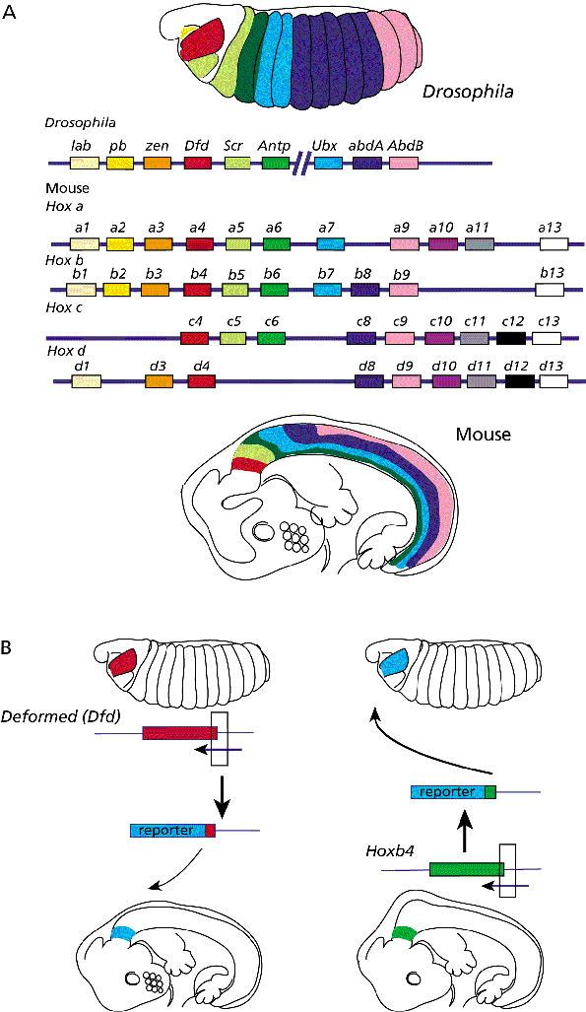
Function is conserved between fly and mouse:

Slide 65
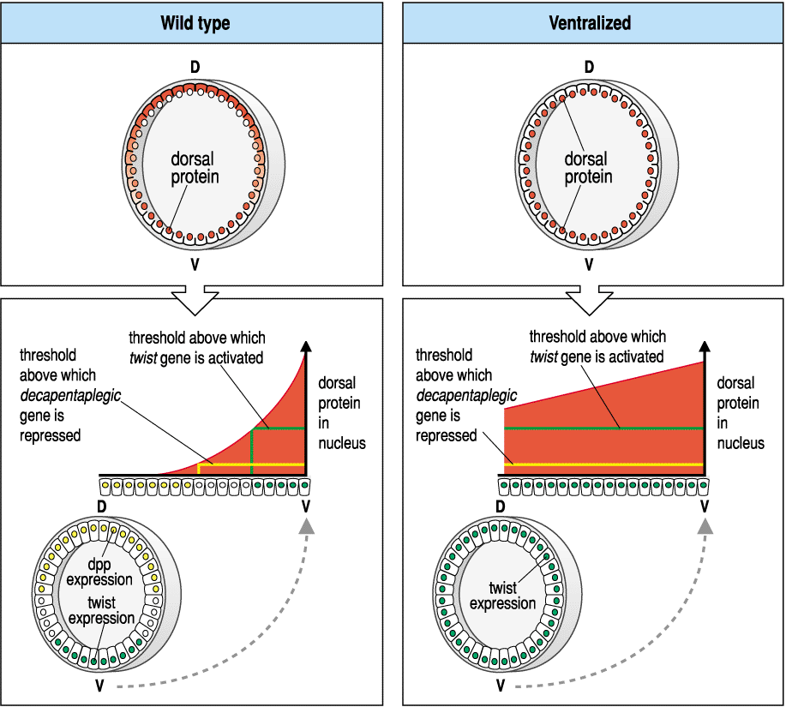
Dorsal-Ventral Patterning depends on a gradient of the morphogen Dorsal, which acts as both an activator and repressor of transcription

Slide 66
The Dorsal gradient results from a complicated protease cascade that results in localized activation of the Toll receptor. But it’s still not known just how the initial asymmetry in D-V patterning is established.
This pathway is also important in the innate immune response in both insects and in mammals.

Slide 67
Toll is found everywhere in the oocyte plasma membrane. But it’s only active on the ventral side:
Toll signaling activates the Pelle ser/thr kinase. This leads to phosphorylation of Cactus, causing its release from Dorsal. Dorsal can then enter the nucleus.
Why is Toll only active on the ventral side?

Slide 68
The Toll ligand is Spätzle. Spätzle becomes activated following cleavage by a serine protease cascade similar to the one used in blood clotting:
Cleaved Spätzle is found only on the ventral side of the egg. This explains why Toll is only active ventrally. On the other hand:
Why is Spätzle only active on the ventral side?

Slide 69
It turns out that the entire protease cascade leading to Toll activation is active only ventrally--but it’s been very hard to determine why. In fact, we still don’t completely understand this.
The dorsally located oocyte nucleus signals to dorsal follicle cells via the EGF-receptor pathway. This causes transcription of the pipe gene to be repressed. Thus, pipe is only produced in ventral follicle cells.
Pipe is the only clearly localized member of the dorsal/ventral patterning genes. It encodes a 2-O-sulfotransferase. However, we do not know all of its substrates or how it initiates the ventral localization of the protease cascade.
Recent work shows that at least some Pipe substrates are components of the vitelline membrane.
Sulfation of eggshell components by Pipe defines dorsal-ventral polarity in the Drosophila embryo. Zhang Z, Stevens LM, Stein D.Curr Biol. 2009 Jul 28;19(14):1200-5.PMID: 19540119

Slide 71
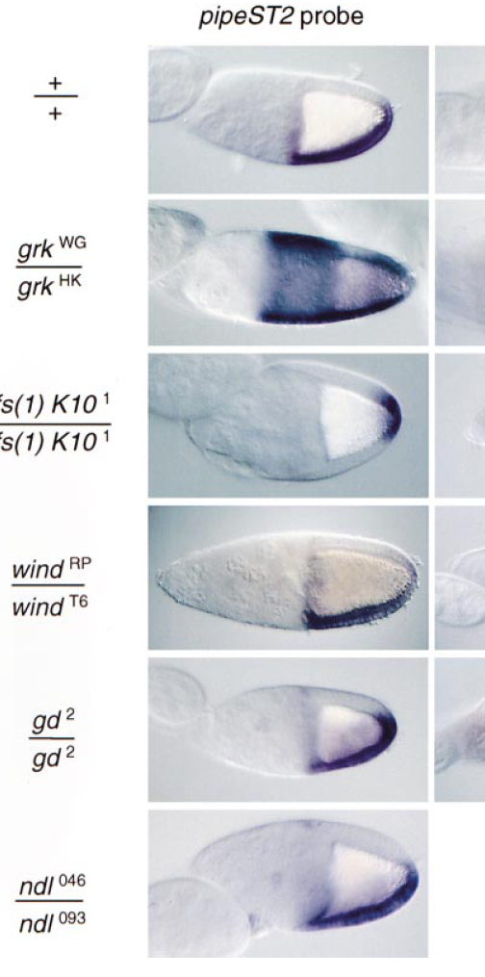
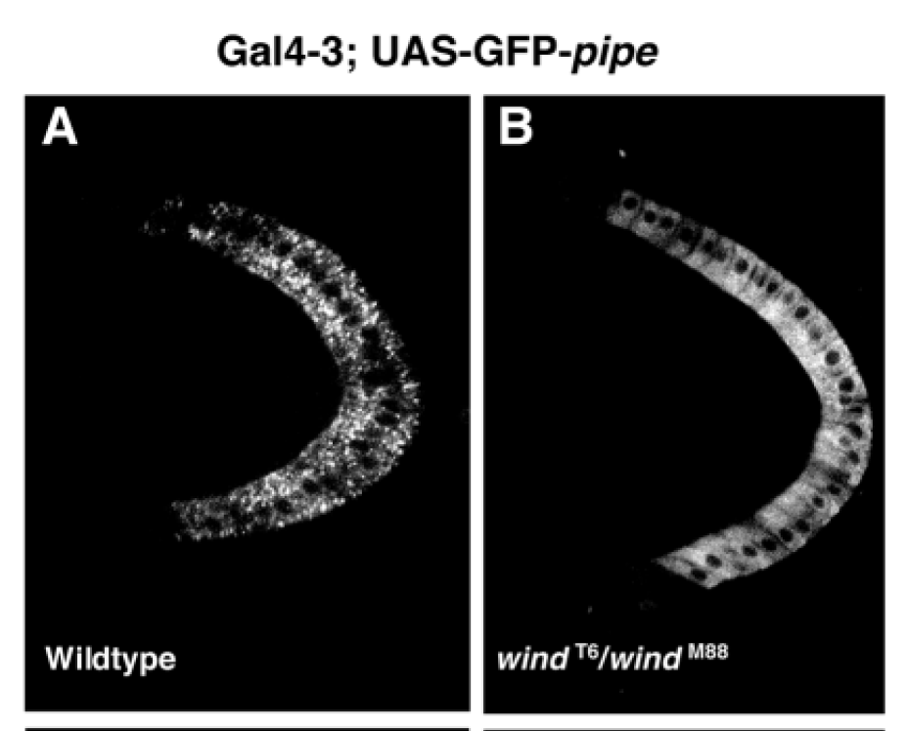
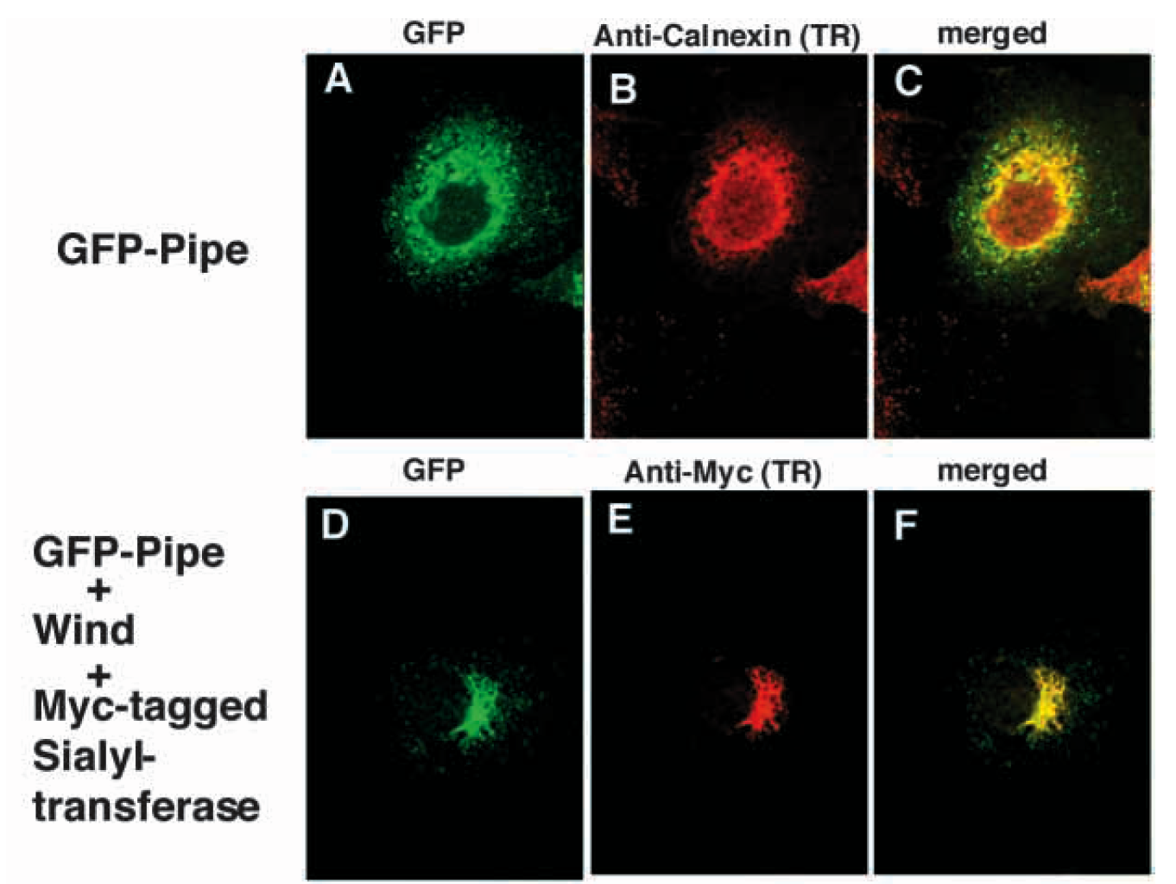
ER
golgi

Slide 72
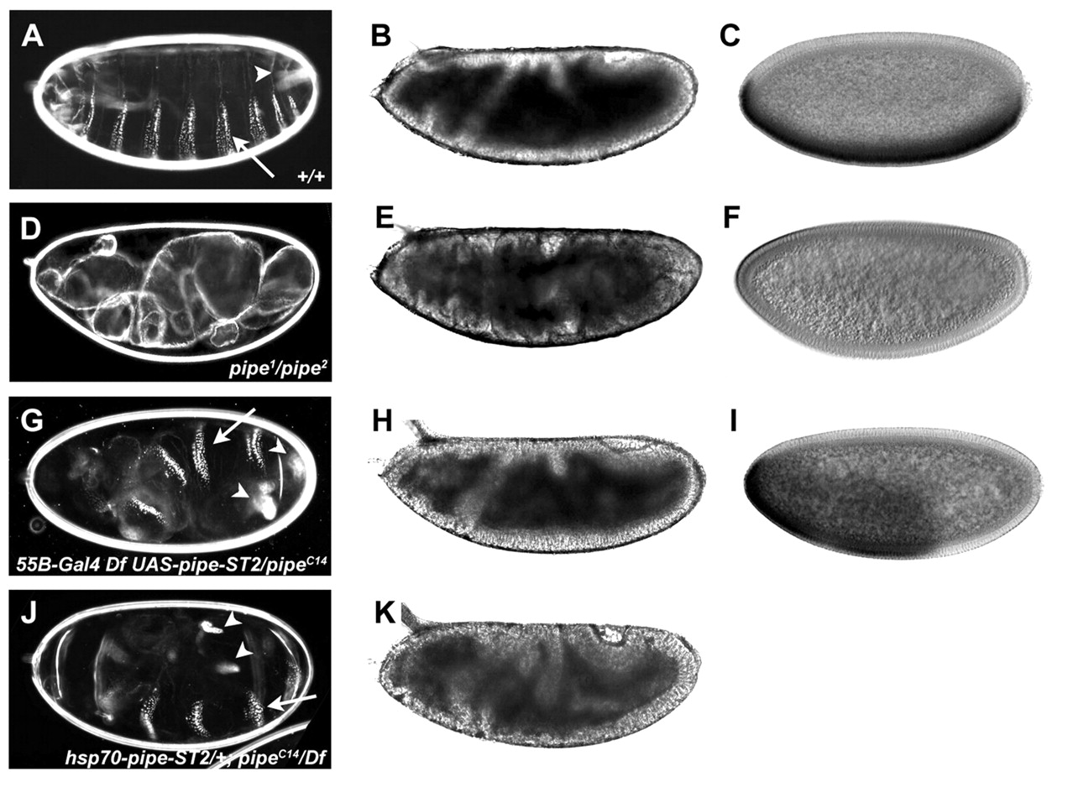
But:
Recent work shows that in the presence of uniformly distributed Pipe, there is still some D-V polarity. So Pipe may not be the only determinant.
Residual DV polarity in embryos from females expressing Pipe-ST2 uniformly around the DV circumference of the follicular epithelium
Zhang, Z. et al. Development 2009;136:2779-2789

Slide 73
Key concepts in dorsal/ventral patterning:
•ultimately depends on a morphogen gradient of a nuclear-localized transcription factor (Dorsal)
•takes place by localized activation of a globally expressed receptor

Slide 75
Strategies for Patterning
ubiquitous receptor, localized activation of ligand (dorsal/ventral system, terminal system)
localized RNA (anterior/posterior)
translational inhibition (posterior)
morphogen gradients (d/v, a/p)
mutual repression (segmentation)
cell-cell signaling (segment polarity)
chromatin remodeling (Hox genes)

Slide 76
Some major players in human disease
Wg: Wnt/β-catenin/APC (oncogenes)
Dpp: TGF- β (oncogene)
Dorsal: rel/NFκB/TLR/IL-1 (immune response)
Ras (oncogene)
HH/ptc/smo/gli (cancer, birth defects)
Runt (hematapoesis, leukemias)
Hox cluster (various birth defects)

Slide 77
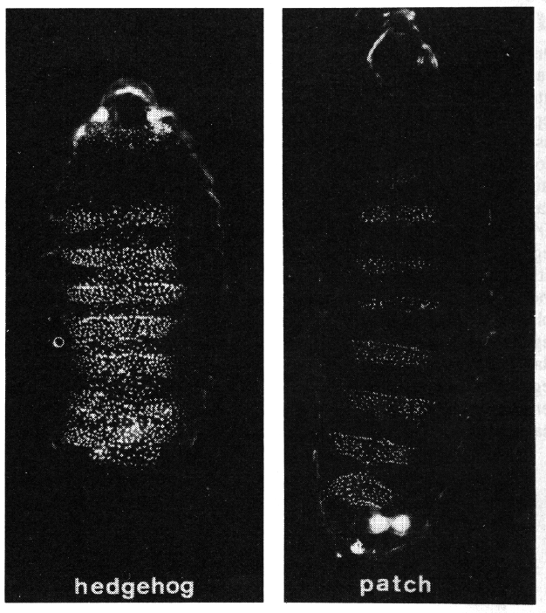
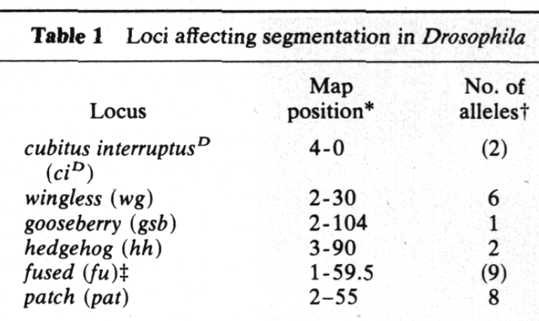

Slide 78
We’ve now seen:

Slide 79
Dorsal-Ventral Patterning:

Slide 80
Anterior-Posterior patterning and Segmentation:

Slide 81
Segment Identity specification:

Slide 82
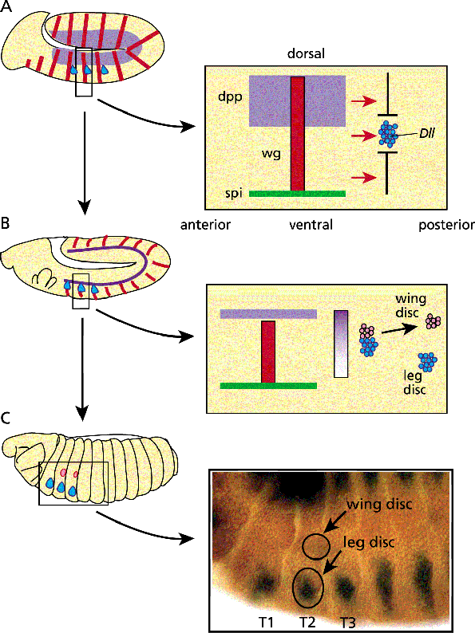
What does this mean for organogenesis?
These early axial patterning and segmentation events set up a coordinate grid on which organs are built

Slide 83
Let’s look at wing and leg imaginal disc formation:

Slide 84
Imaginal Discs

Slide 86
pipe

Slide 89
wing and leg imaginal disc formation: 2nd phase

Slide 90
Here’s a partial view of the Dorsal-Ventral network:
Levine, Michael and Davidson, Eric H. (2005) PNAS 102, 4936-4942

Slide 91
Muscial Interlude
Regulatin' Genes
(http://www.youtube.com/watch?v=9k_oKK4Teco&feature=youtu.be)

Slide 93
Methods: the Gal4 ectopic expression system
Brand and Perrimon, 1993

Slide 94
Methods: P-element mediated transformation
some gametes have integrated transposon

Slide 95
Key concepts in terminal patterning:
Once again, we see local activation of a global receptor.
The end result is a gradient of signaling leading away from the poles—target genes respond to higher or lower levels of MAPK signaling via relief of repression from a global repressor.
Key concepts in dorsal/ventral patterning:
•takes place by localized activation of a globally expressed receptor
•ultimately depends on a morphogen gradient of a nuclear-localized transcription factor (Dorsal)

Slide 96
The main body axes and patterning by maternal effect genes
Termini

Slide 97
Terminal group genes: fs(1)ph, fs(1)N, torso-like, trunk, torso, tll, hkb
mutations in these genes give similar terminal phenotypes
Torso (Tor) is a receptor tyrosine kinase (RTK→Ras→Raf→MEK→MAPK)
Torso and Trunk are evenly distributed around the embryo
activating (gain-of-function) mutations in Torso or Trunk convert the entire embryo into anterior and posterior termini
Torso-like
Torso
fs(1)ph
fs(1)N
Trunk
Furriols and Casanova EMBO J. 22:1947 (2003)

Slide 98
Terminal group genes: fs(1)ph, fs(1)N, torso-like, trunk, torso, tll, hkb
loss-of-function mutations in torso-like (tsl), torso (tor) and trunk (trk) have similar phenotypes
ectopic expression of Tsl leads to ectopic activation of Tor
Trk looks like a ligand
Trk is uniformly distributed in the oocyte
Trk has a putative cleavage site which creates a null mutation when mutated
Trk C-terminal can activate Torso even in absence of tsl, fs(1)ph and fs(1)N
on the other hand, ectopic tsl expression still requires trk, fs(1)ph and fs(1)N to induce gain-of-function phenotypes

Slide 99
The termini are determined by localized activation of the Torso receptor tyrosine kinase
fs(1)ph
fs(1)N
vitelline membrane x-linking
tsl accumulation/stablility
soma
Torso-like (tsl)
Trunk (ligand)
Torso (RTK)
Ras/Raf/MAP Kinase/etc.
capicua (cic) + gro
germline
hkb
tll
Furriols and Casanova EMBO J. 22:1947 (2003)

Slide 100
The termini are determined by localized activation of the Torso receptor tyrosine kinase
(Cic/Gro)
repressed by Bicoid in anterior

Slide 101
Key concepts in terminal patterning
• Local activation of a global receptor
• The end result is a gradient of signaling leading away from the poles—target genes respond to higher or lower levels of MAPK signaling via relief of repression from a global repressor

